Slide 1
LoRaWan Agriculture
-sujith

Slide 2
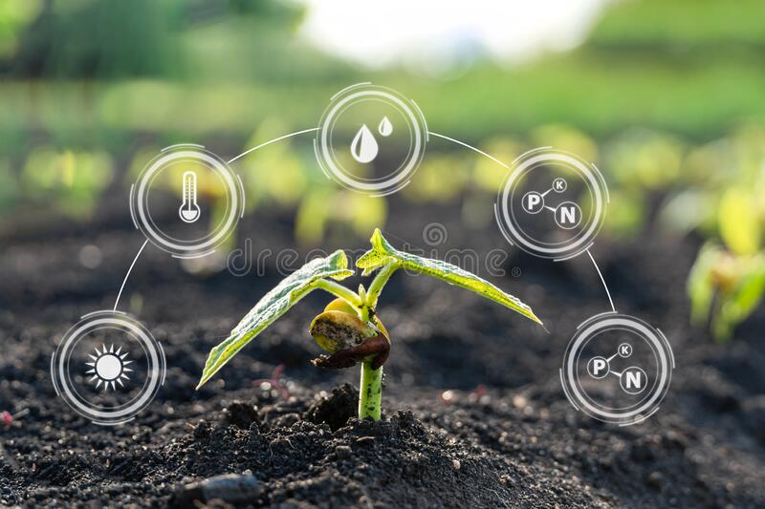
Agriculture is a field of Unlimited posiblities.

Slide 3
why and what?
1

Slide 4
Problem statement:
Lack of knowledge.
Network issues in rural areas.
Difficulties in handling technologies.
Disadvantages in monitoring larger areas.

Slide 5
solution..?
2

Slide 6
Proposed solution:
Monitoring large areas - LoRa nodes.
Operations control by BLYNK App or Gmail.
Adding Google firebase for future uses.
Over come network issues using LoRa wan .
Monitoring climatic conditions using Arduino sensors.

Slide 7
Components:
LoRa transmitter
Arduino UNO
LM 35 Sensor
DHT 11 sensor
LCD Display
AC motor

Slide 8
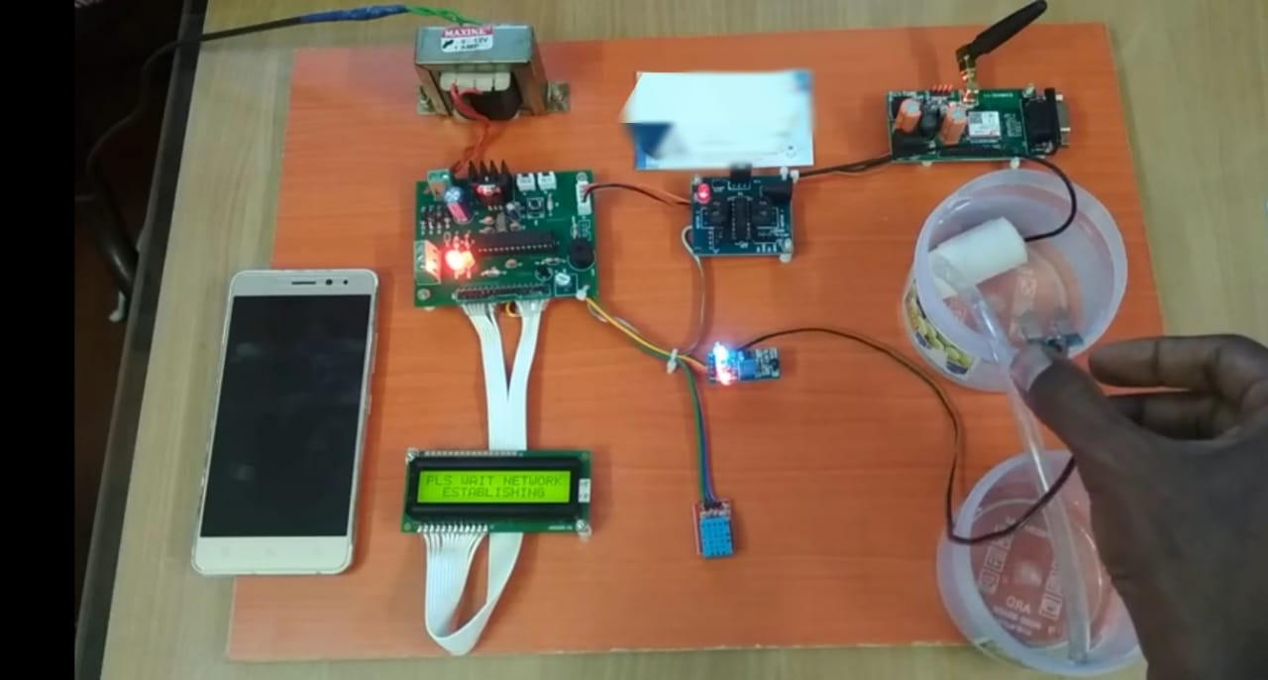
working:
EDIT IN GOOGLE SLIDES
Click on the button under the presentation preview that says "Use as Google Slides Theme".
You will get a copy of this document on your Google Drive and will be able to edit, add or delete slides.
You have to be signed in to your Google account.
More info on how to use this template at slidescarnival.com/help-use-presentation-template
This template is free to use under Creative Commons Attribution license. You can keep the Credits slide or mention SlidesCarnival and other resources used in a slide footer.

Slide 9
implementation:
DHT 11
App or Gmail
LoRa transmitter
LM 35
LCD Display
Turn on func
moisture
Turn off func
complete func

Slide 10
revenue stream:
Product price : 4000
Product price with
packaging& : 5000
Transportation
Selling price : 7000
Profit amount : 2000
Profit margin : 28.5%

Slide 11
The discovery of the Agriculture was the first big step towards
Civilised life.

Slide 12
Thanks!
Any questions?
https://github.com/sujithselvaraj/LoRawan-Agriculture/tree/main

